Slide 1




Book Heaven
Online Book
Store
Major Project
Presented by Vishwas Chourasiya

Slide 2


WELCOME
In My Major Project

Slide 3

﻿Table Of Contents
1
INTRODUCTION
2
FEATURE
3
OBJECTIVE
4
TEACNOLOGY & REQUIREMENTS
5
DATA FLOW DIAGRAM
6
ER-DIAGRAM
7
SCREEN-SHOTS OF PROJECT

Slide 4


﻿Introduction
The Book Store project aims to create an online platform for purchasing books with various features and functionalities.
Book Heaven: Your Literary Haven
Book Heaven is an online bookstore dedicated to providing a diverse selection of books at discounted prices.
Users can explore a wide range of genres, read reviews, and engage with blog content.

Slide 5

Features
Responsive design for seamless browsing across devices.
Search functionality for easy book discovery.
Featured books and new arrivals sections.
Reviews and blogs sections for user engagement.
Deals of the day for enticing offers.
Secure payment and easy returns policy.
Successful Implementation The project has been successfully implemented, providing users with an intuitive and engaging online bookstore experience.
Positive feedback from users, indicating satisfaction with the website's design and functionality.

Slide 6
Objective
The objective of the online book store project is to provide a user-friendly platform for customers to browse, purchase, and review books, enhancing accessibility and convenience in acquiring reading materials.
To Create an Engaging Online Bookstore The primary aim of the project is to develop an online platform that offers a seamless browsing and purchasing experience for book enthusiasts.
Emphasis on user experience, convenience, and accessibility.

Slide 7
TECHNOLOGY USED
The success of the Online book store Projectiles in the smart selection of technologies that underpin its functionality and performance. We have carefully chosen a robust and versatile technology stack to ensure a seamless user experience and efficient management of financial data. Here's an overview of the technology stack we've employed:
1. Front-End Development: 1. HTML (Hypertext Markup Language): The foundational language for creating the structure and layout of web pages.

Slide 8
CSS (Cascading Style Sheets): Used to style and design the user interface, ensuring a visually appealing and consistent appearance.
JavaScript: Employed for interactive elements, dynamic content, and enhancing user experience.
Back-End Development:
PHP (Hypertext Preprocessor): A server-side scripting language used to handle dynamic content generation and interactions with databases.
MySQL: A relational database management system for efficiently storing and managing expense data and user information.

Slide 9
﻿System Requirements
HARDWARE CONFIGURATION
SOFTWARE CONFIGURATION
Processor : AMD Ryzen 3 5300U
RAM : 8 GB RAM
Hard Disk Drive: 512 GB SSD
Keyboard : 104 keys
Mouse : HP Mouse
Monitor :Generic PnP monitor
Display Type : AMD Radeon Graphics
Operating System : Windows 11
Web server : Personal Web Server
Web Browser : CHROME
Designing Tool : HTML, CSS , Font Awesome
Server Side Scripting : XAMPP
Client Side Scripting : JS
Backend : MYSQL

Slide 10
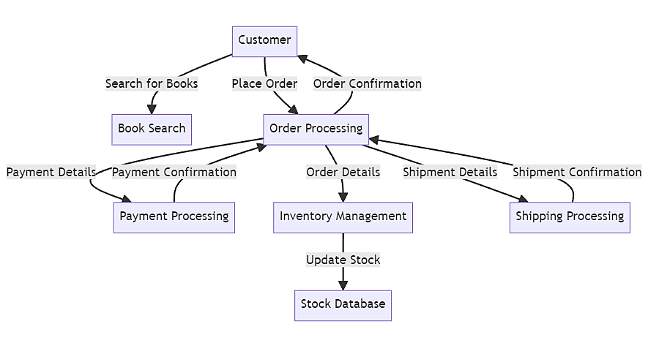
Data Flow Diagram
The Data Flow Diagram (DFD) for the online book store website project illustrates user interactions, including browsing, searching, ordering, and payment processes, facilitating efficient data flow and transaction management.

Slide 11
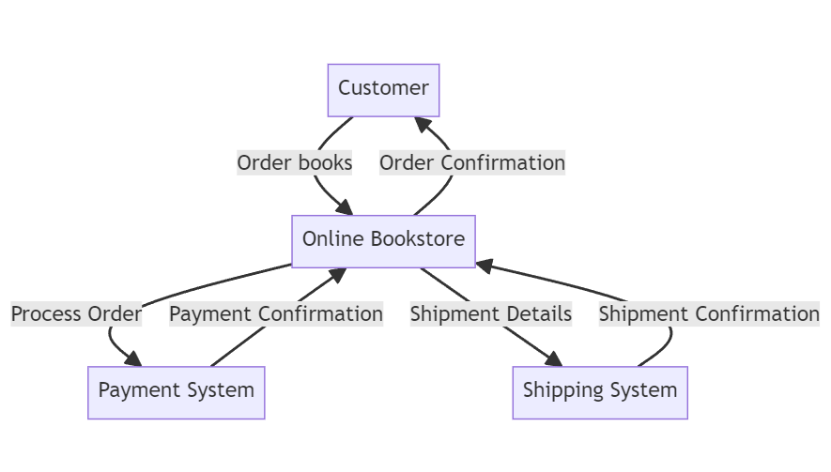
0-Level DFD

Slide 12
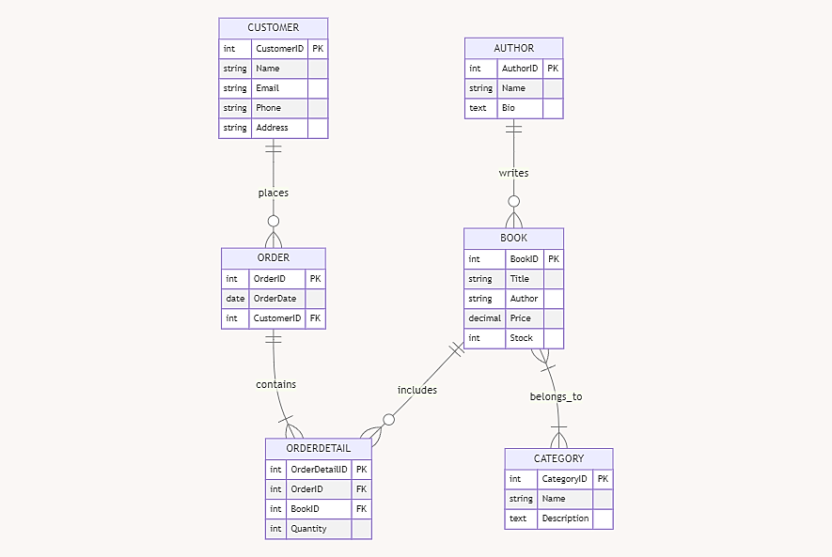
ER-Diagram

Slide 13
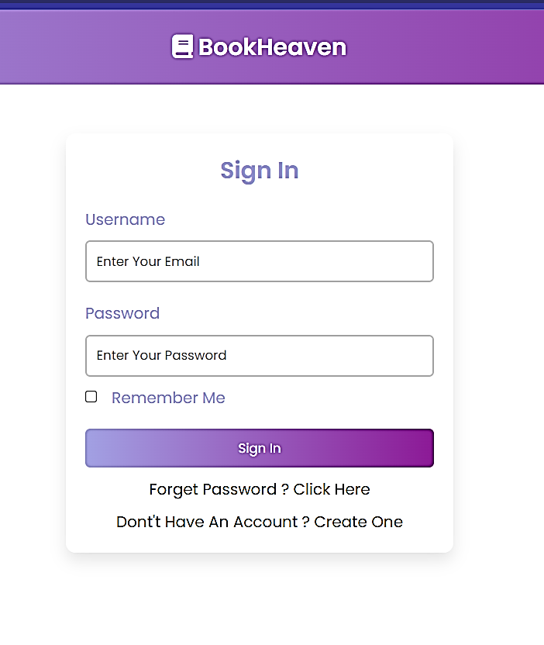
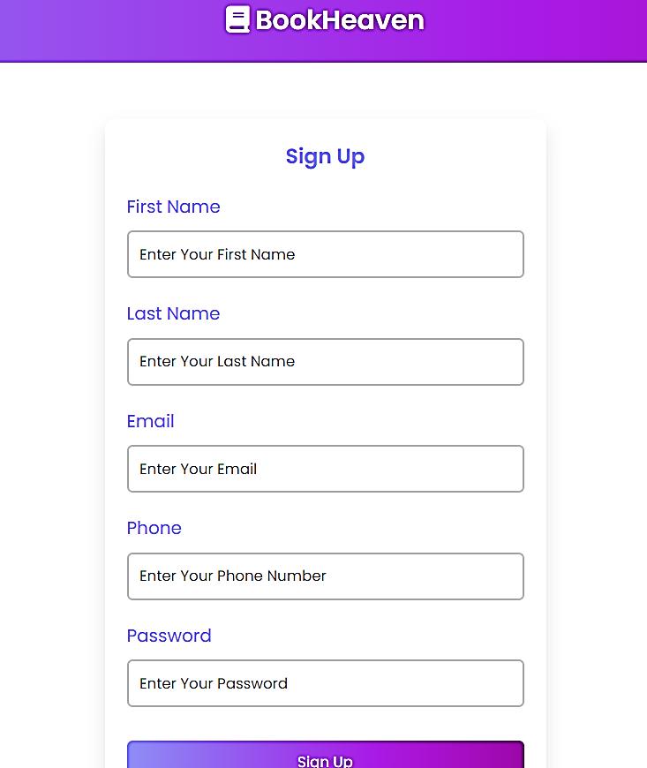
﻿Sign-In & Sign-up Page

Slide 14
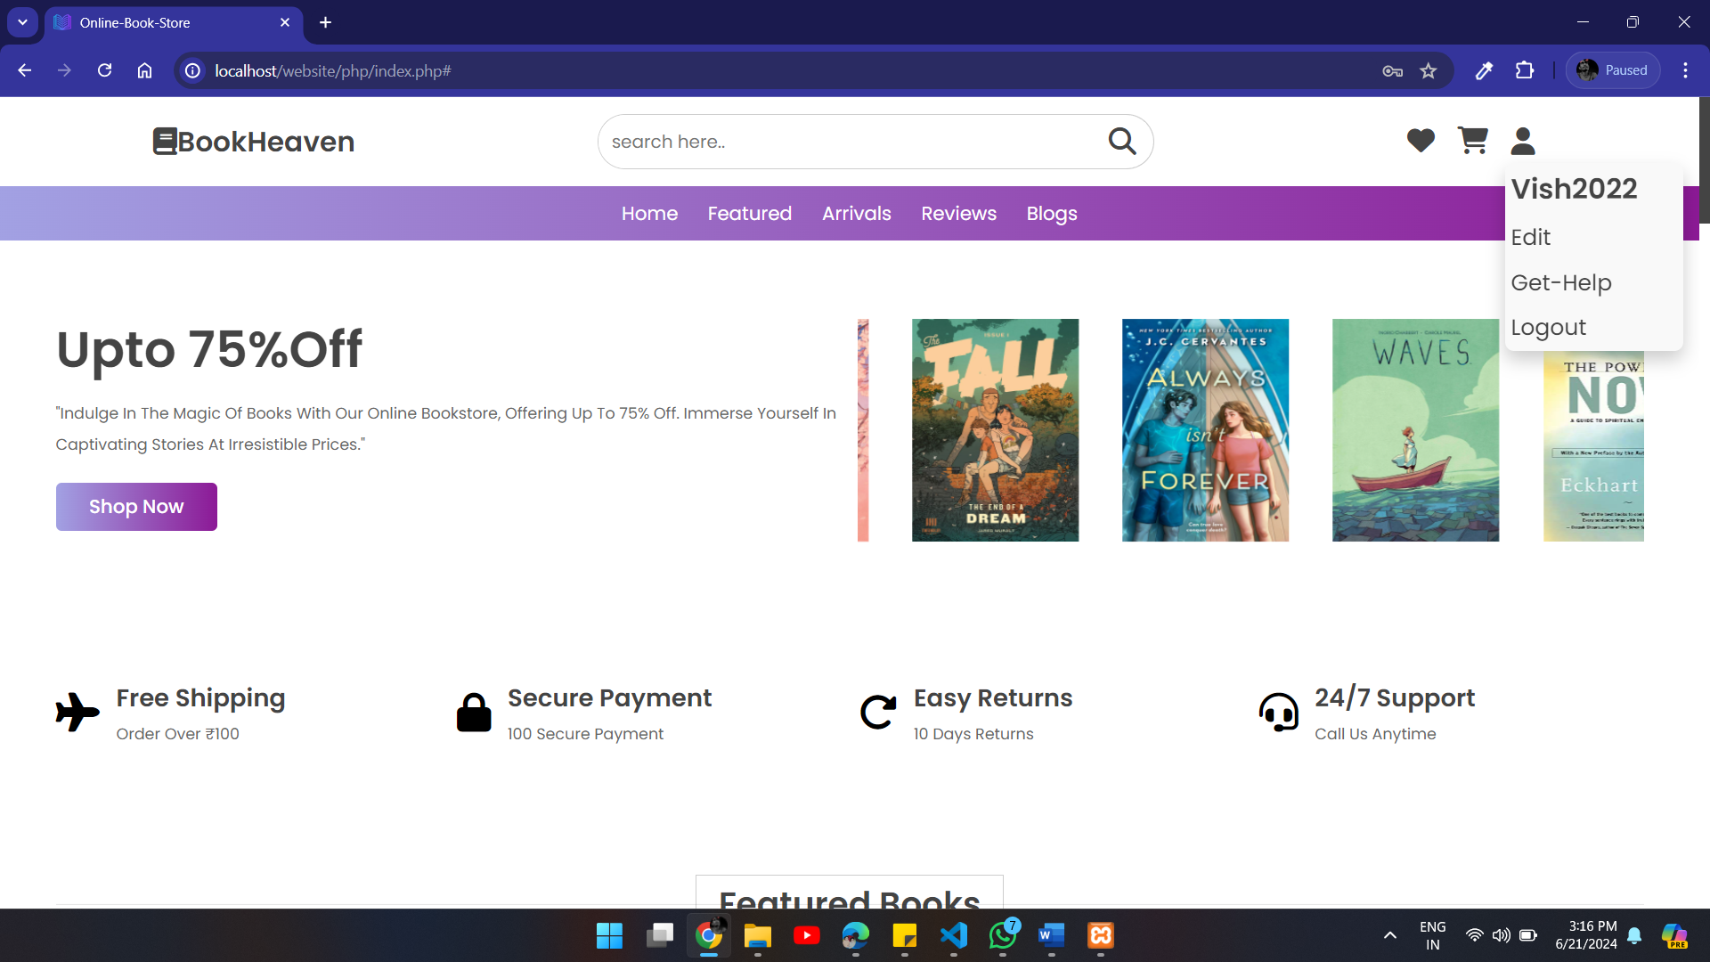
Landing Page Of Book-Heaven

Slide 15
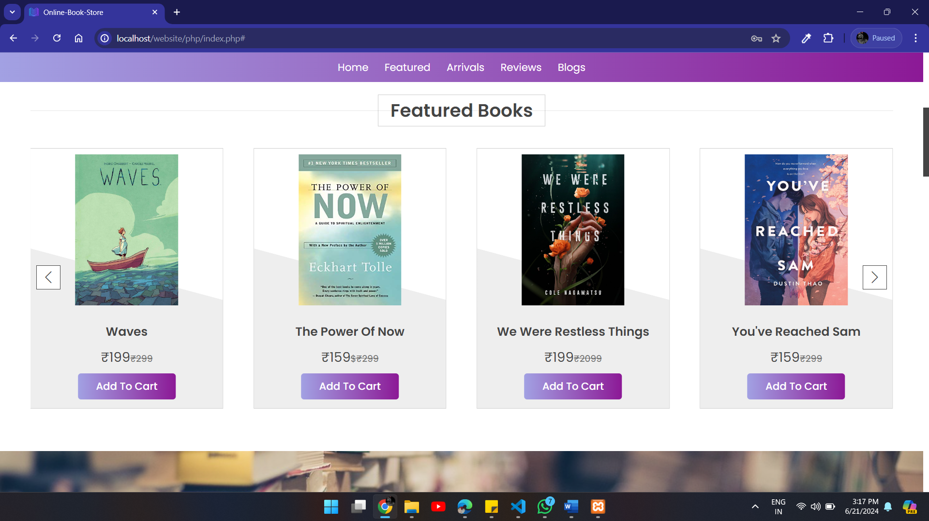
﻿Categories

Slide 16
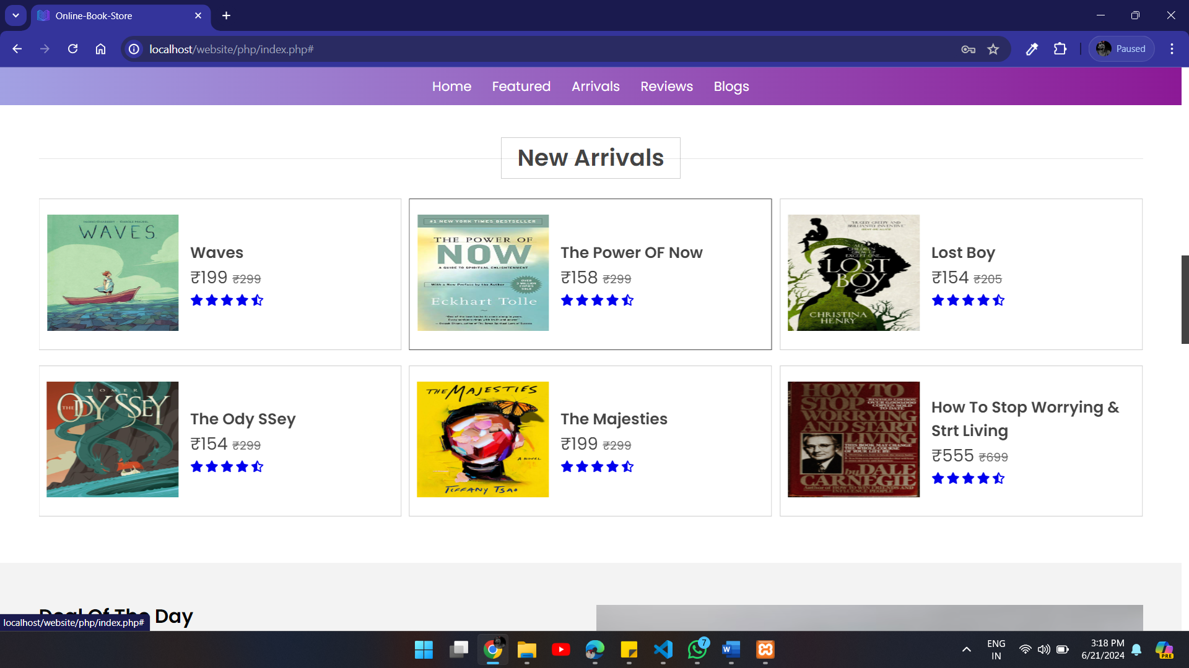
﻿Categories

Slide 17
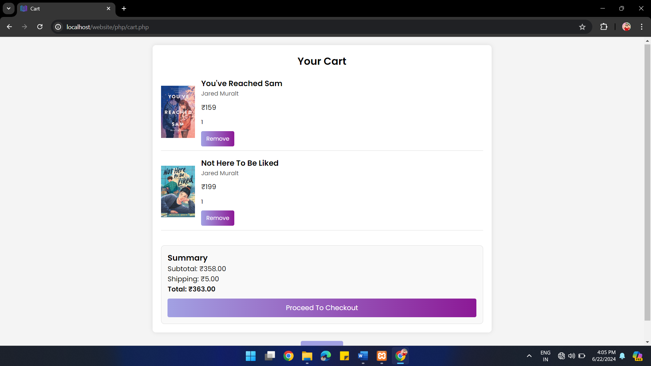
﻿Cart

Slide 18
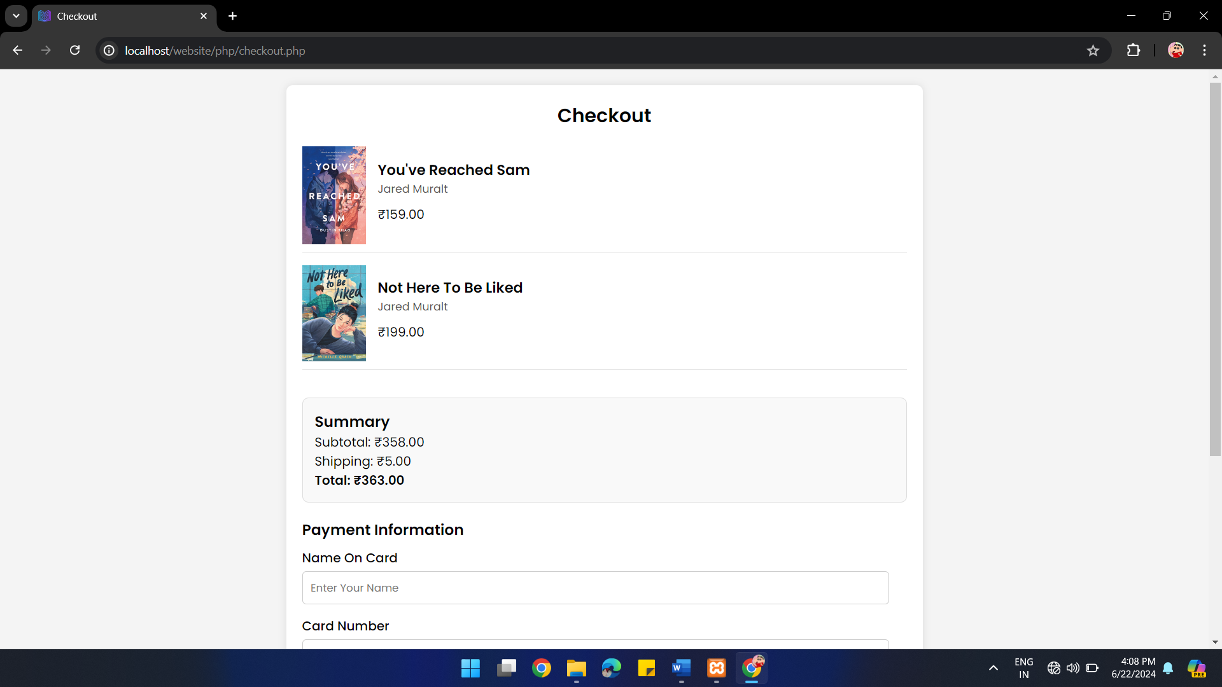
Checkout

Slide 19
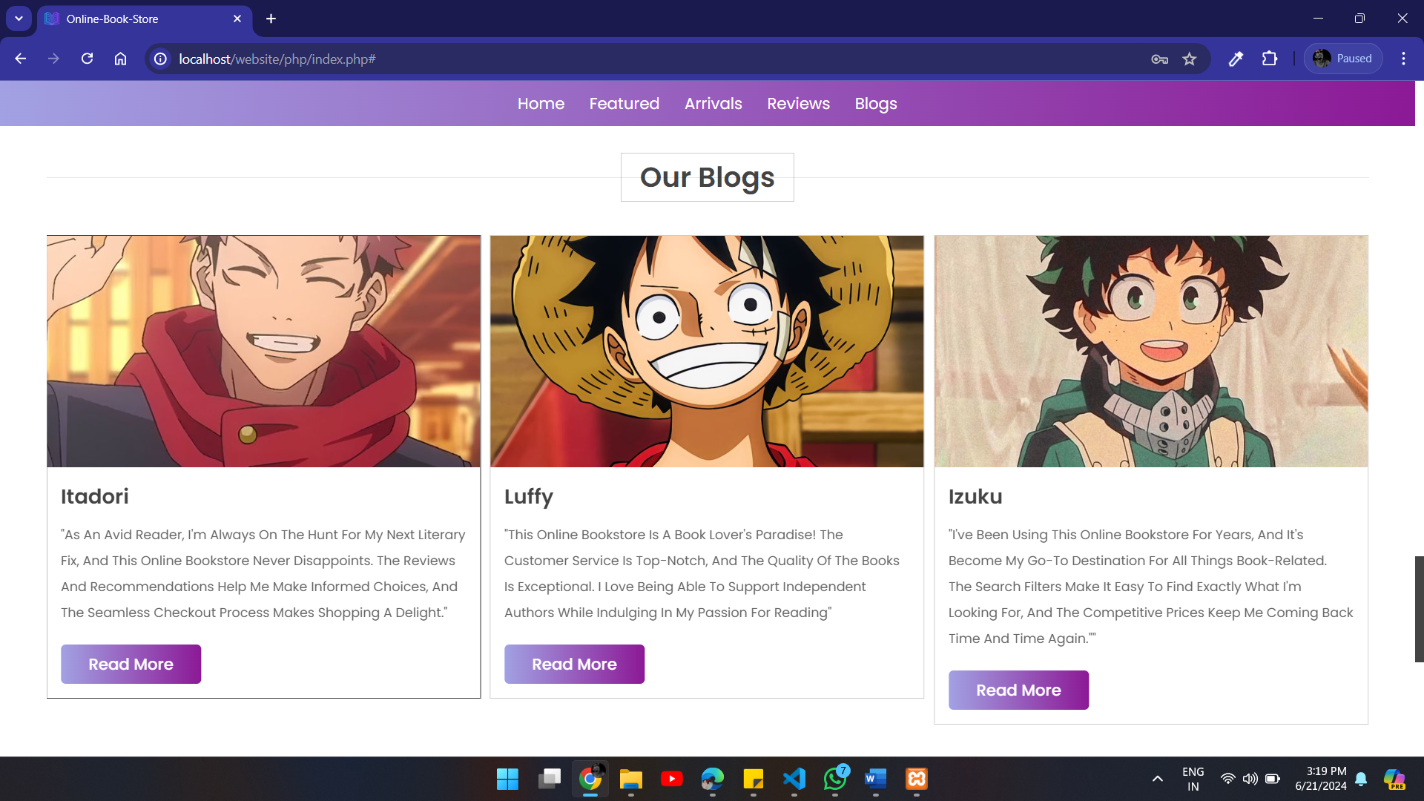
﻿Blogs & Contacts

Slide 20
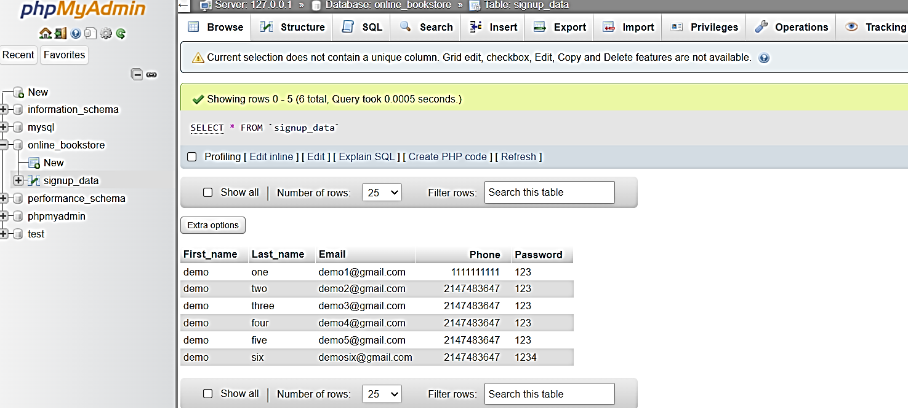
﻿Database Table Of Sign-In Info.

Slide 21
Online-Book-Store
Sign-Up New User by Sign-up Form
Login Using email As Username
Login On Home Page of Website
Now you Can use many Services
User make there username and password
Use Right password
Here you can change your Information.
Books, cart, Review etc.

Slide 22
Book Heaven
﻿THANK YOU
“For Giving Your Precious Time"

